Slide 1
Week 5
Statistical Testing

Slide 2
Statistical Testing
Statistical testing is a technique to analyze data to derive past trends and predict future events on the basis of them. It helps to understand importance of a certain feature.
For accurate prediction of model only significant features are required statistical testing helps to eliminate the redundant features and keep only significant features

Slide 3
Chi-Square
In week 4 we visualized the data and were able to find out the features which leads to PCOS disease. But the significance of those features were not proved statistically so are going to pick two random features and we will apply chi-square test and will observe our observation in week 4 we were not using hypothesis testing.

Slide 4
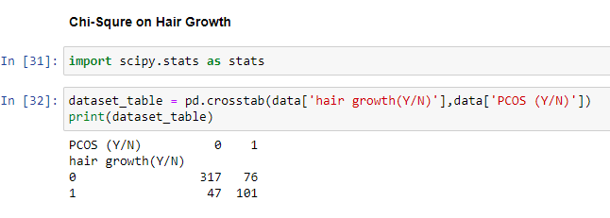
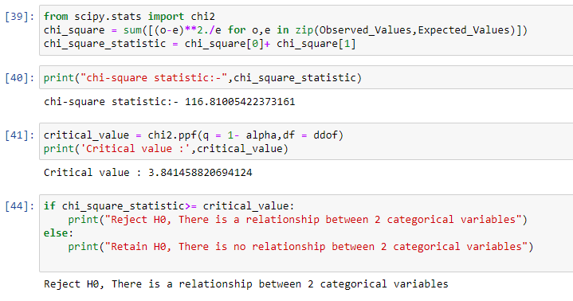
Chi-Square
Created a contingency table of Hair Growth(Y/N) and PCOS
It can observed that according to Chi-Square test there is a relationship of these two features

Slide 5
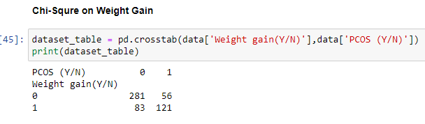
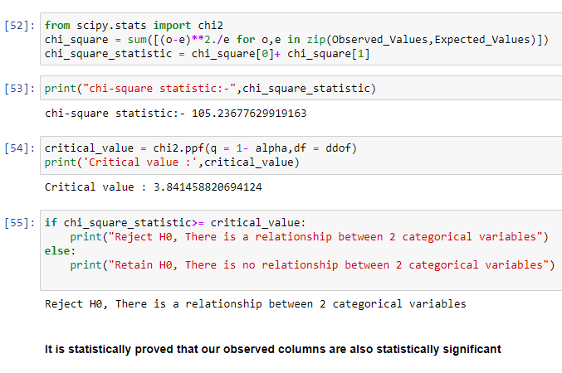
Chi-Square
Created a contingency table of Weight Gain(Y/N) and PCOS

Slide 6
Applying Machine Learning Algorithm
After statistical testing we will create machine learning model to predict PCOS based on selected symptoms patients will have PCOS or not.
For this week I choose Logistic Regression model to train on my dataset and observed the results. In next week I will apply a few advanced machine learning algorithms.

Slide 7
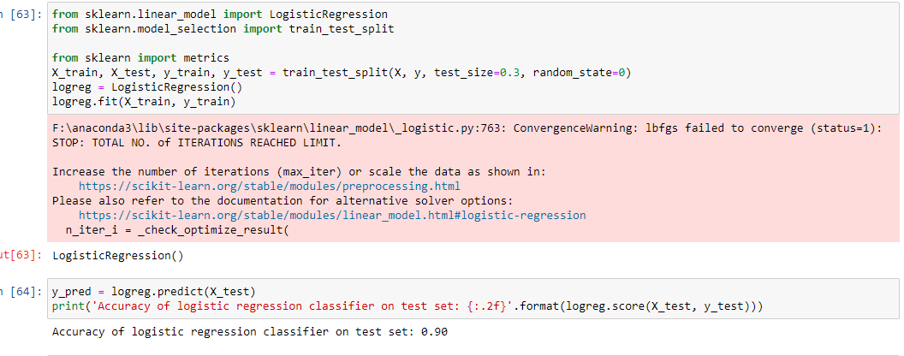
Logistic Regression
Before applying logistic regression we are splitting data into 70% training and 30% testing ratio.

Slide 8
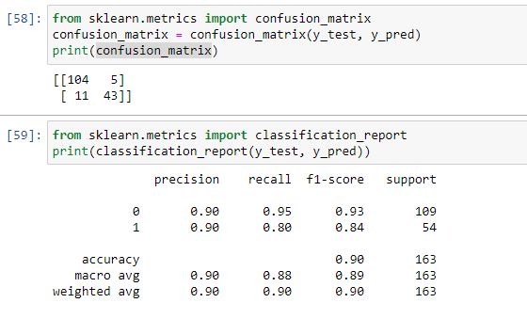
Logistic Regression
The accuracy of the model is 90% which is not bad but it can be improved if we apply some advanced algorithms

